Slide 1
ORIENTING ACADEMY SATELLITES
1.5-acre school-based leased/rented property model
Across Bangalore | Ages 4+ | All 36 LA28 Olympic sports
1.5 ac
School site
36
Olympic sports
Rs.2 Cr
Opening capex
50
Y10 satellites
Orienting Academy Satellite | 1

Slide 2
Executive thesis
Do not buy land first. Lease/rent under-utilised school assets after hours.
Create a standardised school-satellite operating model across Bangalore.
Provide sport, after-school care, tutoring, safety, camps, leagues and community programming.
Use the flagship academy as curriculum, coach and tournament hub.
Orienting Academy Satellite | 2

Slide 3
Evidence and source hierarchy
Official sources are used for Olympic programme, schools, demographics, safety, security and food compliance.
Directories and provider pricing are used only as market signals.
Lease, staffing, demand and revenue assumptions need pilot validation.
Orienting Academy Satellite | 3

Slide 4
Bangalore school opportunity
Schools have trusted parent relationships and under-used fields/courts after hours.
Satellite model turns school assets into after-school family services and revenue share.
UDISE+ / Know Your School should be used for target-school verification.
Orienting Academy Satellite | 4

Slide 5
Satellite product architecture
MOVE: multi-sport and Olympic discovery.
LEARN: homework, tutoring, STEM and Olympiad support.
LEAD: leadership, leagues, team roles and camps.
LIVE: safe custody, snack/dinner option, pickup, health and parent communication.
Orienting Academy Satellite | 5

Slide 6
Age groups from 4+
Segment | Age | Focus | Ratio
Foundation | 4-6 | Movement literacy, play, mini sports, balance, rhythm, social behaviour | 1:8
Discovery | 7-9 | Multi-sport sampling, coordination, game rules, teamwork | 1:10
Development | 10-12 | Technique, discipline, athletics base, study habits | 1:12
Performance | 13-15 | Sport choice, S&C, school leagues, leadership | 1:15
Pre-elite | 16-18 | Performance, officiating, coaching assistant, career orientation | 1:15
Young adult | 18-25 | Recreation, coaching internships, leagues | 1:18
Orienting Academy Satellite | 6

Slide 7
All 36 Olympic sports - model logic
All 36 sports are included in the portfolio.
A 1.5-acre site cannot host all sports at competition standard.
Sports are classified as on-site, hybrid or partner/off-site.
The goal is exposure, assessment and pathway, not overbuilding.
Orienting Academy Satellite | 7

Slide 8
Olympic sports matrix 1
Sport | Mode | Fit | Age
Aquatics | Partner/off-site | Low | 4
Archery | On-site controlled | Medium | 8
Athletics | On-site | High | 4
Badminton | School indoor/covered | High | 5
Baseball/Softball | On-site/shared field | Medium | 6
Basketball | School court | High | 5
Boxing | Indoor room | Medium | 10
Canoe | Partner/off-site | Low | 10
Cricket | On-site | High | 5
Cycling | Hybrid | Medium | 6
Equestrian | Partner/off-site | Low | 6
Fencing | Indoor room | Medium | 8
Flag Football | On-site/shared field | Medium | 6
Football | On-site | High | 4
Golf | Partner/off-site | Low | 6
Gymnastics | Indoor room | High | 4
Handball | School court/shared field | Medium | 7
Hockey | On-site/shared field | High | 6
Orienting Academy Satellite | 8

Slide 9
Olympic sports matrix 2
Sport | Mode | Fit | Age
Judo | Indoor mat | Medium | 5
Lacrosse | On-site/shared field | Medium | 8
Modern Pentathlon | Hybrid | Low | 10
Rowing | Partner/off-site | Low | 10
Rugby | On-site/shared field | Medium | 6
Sailing | Partner/off-site | Low | 10
Shooting | Regulated/partner | Low | 10
Skateboarding | Portable skills zone | Medium | 6
Sport Climbing | Partner / portable wall | Medium | 6
Squash | School/partner indoor | Medium | 7
Surfing | Partner/off-site | Low | 10
Table Tennis | Indoor room | High | 5
Taekwondo | Indoor mat | Medium | 5
Tennis | School/partner court | Medium | 5
Triathlon | Hybrid | Medium | 8
Volleyball | School court/shared field | Medium | 8
Weightlifting | Indoor S&C room | Medium | 12
Wrestling | Indoor mat | Medium | 6
Orienting Academy Satellite | 9

Slide 10
1.5-acre site use
Zone | Use
Shared field | Football, cricket, athletics, rugby, lacrosse, flag football, hockey basics
Cricket nets | Portable/semi-permanent nets
Court/hard surface | Basketball, volleyball, handball, mini tennis
Indoor room 1 | Homework, tutoring, STEM
Indoor room 2 | TT, mats, fencing, boxing fitness
Medical/admin | First aid, storage, admissions
Gate/lounge | Controlled pickup and parent wait
Orienting Academy Satellite | 10

Slide 11
Daily operating rhythm
Time | Activity
2:30-3:30 | Handover + attendance + snack
3:30-5:00 | Foundation/discovery sport
5:00-6:30 | Development/performance sport
6:30-7:45 | Homework/tutoring/leadership
7:45-8:30 | Extended pickup/dinner
Weekend | Leagues, camps, rentals, corporate/NGO
Orienting Academy Satellite | 11

Slide 12
After-school programme
Core parent proposition: safe custody + sport + homework + food + pickup control.
Age 4-6 uses play-based movement and lower ratios.
Residential is not the default satellite model; it can be tested only after legal and school approval.
Orienting Academy Satellite | 12

Slide 13
Tutor and academic staffing
Role | FTE | Cost
Academic/Homework Lead | 1 | Rs.50k
Tutors | 4 | Rs.35k
STEM Tutor | 1 | Rs.40k
Care Supervisors | 3 | Rs.28k
Orienting Academy Satellite | 13

Slide 14
Coach staffing and sport delivery
Role | FTE | Cost
Head Coach Multi-sport | 1 | Rs.65k
Core Coaches | 4 | Rs.40k
Assistant Coaches | 6 | Rs.25k
Visiting Specialists FTE | 2 | Rs.45k
Orienting Academy Satellite | 14

Slide 15
Security and housekeeping manpower
Role | FTE | Cost
Security Supervisor | 1 | Rs.35k
Security Guards | 4 | Rs.25k
Female Safety Officer | 1 | Rs.27k
CCTV / Access Desk | 1 | Rs.30k
Housekeeping Supervisor | 1 | Rs.28k
Housekeepers | 4 | Rs.22k
Grounds / Equipment | 2 | Rs.25k
Orienting Academy Satellite | 15

Slide 16
Security protocols
Protocol | Control
Background checks | Police/background verification
PSARA | Use licensed/compliant security agency
Gate control | Visitor log and school handover
Pickup | Approved pickup list + QR/OTP
CCTV | Common areas and fields only
Fire/emergency | Drills, exits, assembly point
Medical | Nurse/first aid/hospital tie-up
Transport | Verified drivers, GPS and handover
Orienting Academy Satellite | 16

Slide 17
Opening capex
Item | Rs lakh
Portable sports equipment | 35.0
Cricket nets / removable lanes | 25.0
Field leveling / marking / drainage repairs | 20.0
Lighting / electrical | 30.0
Indoor room fit-out | 20.0
Security systems / CCTV / access | 15.0
First-aid / medical room | 5.0
Pantry / snack counter | 5.0
Technology / attendance / app setup | 8.0
Furniture / storage | 7.0
Signage / branding | 5.0
Pre-opening / launch / training | 10.0
Contingency | 15.0
Orienting Academy Satellite | 17

Slide 18
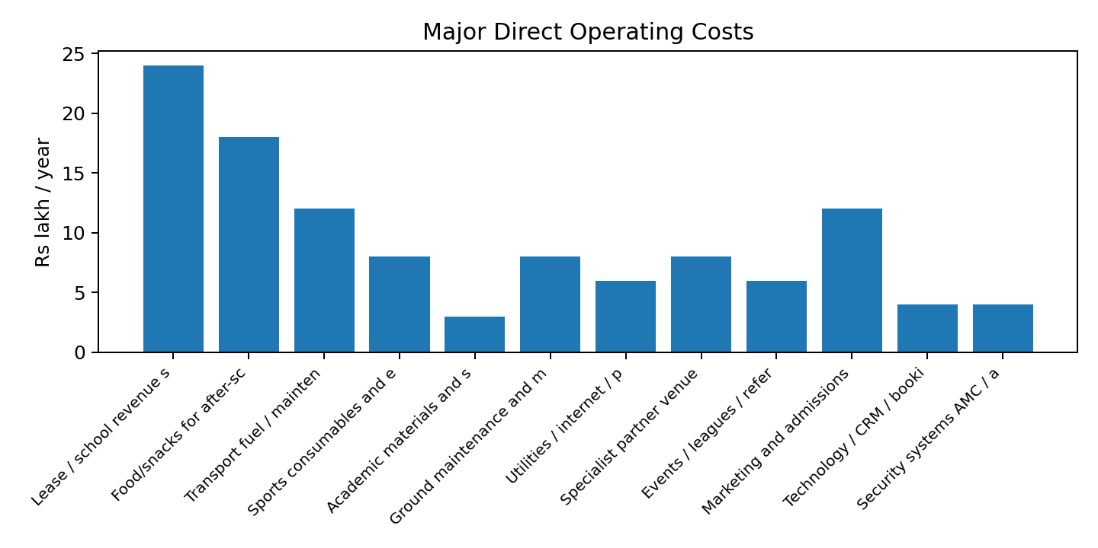
Operating costs and overheads
Operating model includes lease, payroll, food, transport, grounds, security systems, housekeeping supplies, insurance, compliance and central management allocation.
Orienting Academy Satellite | 18

Slide 19
Revenue engines
Revenue engine | Annual Rs lakh
Sports academy memberships | 122.5
After-school standard | 135.0
After-school extended | 84.0
Academic/homework add-on | 42.0
STEM/enrichment add-on | 14.4
Holiday camps | 32.4
School contract / PE support | 6.0
Facility rental - evenings/weekends | 12.0
Inter-school leagues/events | 12.0
Corporate weekend programmes | 12.0
NGO / CSR programmes | 15.0
Merchandise / nutrition / cafe margin | 6.0
Transport subscriptions | 20.0
Orienting Academy Satellite | 19

Slide 20
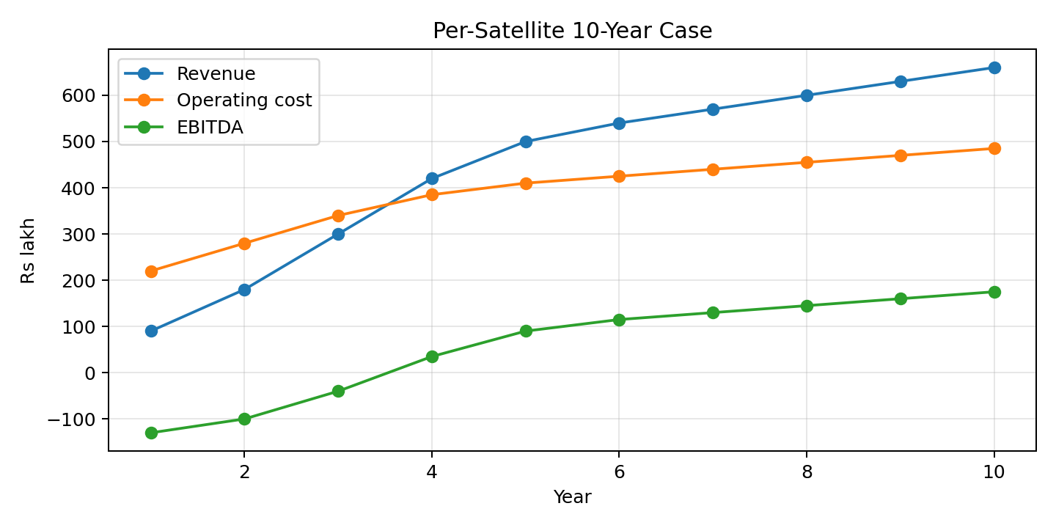
Per-satellite 10-year economics
Ramp-up loss in first years is expected.
Y7 stabilised proxy: Rs.570 lakh revenue and Rs.130 lakh EBITDA.
Orienting Academy Satellite | 20

Slide 21
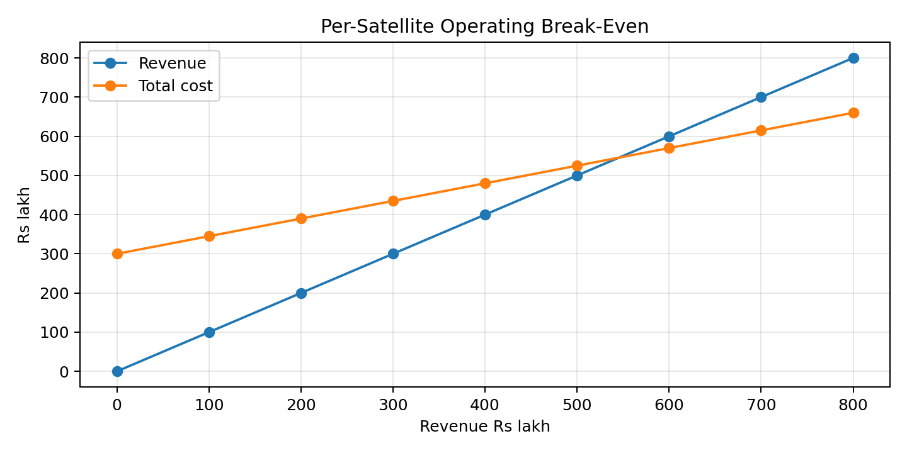
Per-satellite break-even
Operating BEP: approx. Rs.545 lakh revenue/year.
Validate with actual lease and salary quotes.
Orienting Academy Satellite | 21

Slide 22
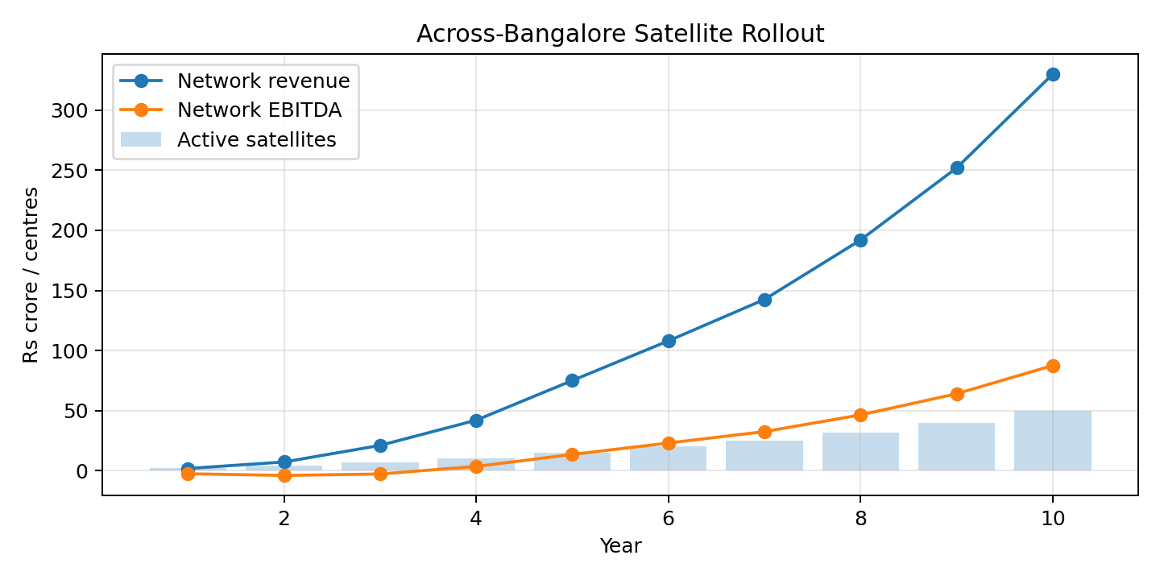
Across-Bangalore rollout
Illustrative Y10: 50 satellites, Rs.330 Cr network revenue and Rs.87.5 Cr EBITDA.
Orienting Academy Satellite | 22

Slide 23
Cluster strategy
Start with 2 pilot schools, then build clusters.
Each cluster should share coaches, events, procurement and supervision.
Prioritise areas with school density, working parents and evening access.
Avoid signing many leases before proof of demand.
Orienting Academy Satellite | 23

Slide 24
School MoU commercial structure
Fixed rent: predictable for school, higher risk for operator.
Revenue share: lower fixed cost, requires transparent reporting.
Hybrid: minimum guarantee plus revenue share is preferred.
MoU must define hours, spaces, safety, liability, data, branding and termination.
Orienting Academy Satellite | 24

Slide 25
Corporate / NGO / school B2B
School contracts, PE outsourcing and inter-school leagues.
Corporate weekend leadership and sports days.
CSR-funded inclusion and scholarship programmes.
Sports management services can scale beyond individual satellites.
Orienting Academy Satellite | 25

Slide 26
Risk dashboard
Risk | Mitigation
Weak school MoU | Legal template + approval gate
Low enrolment | Paid pre-sales before launch
Safety incident | Protocols + training + verification
Facility conflict | Timetable and escalation
Coach quality | Coach academy + audits
Profit variance | Cluster P&L reviews
Orienting Academy Satellite | 26

Slide 27
90-day pilot plan
Select three candidate schools across different clusters.
Run facility/safety audits and school MoU discussions.
Complete parent survey and paid pre-registration campaign.
Obtain quotes for equipment, lighting, security and housekeeping.
Launch 2 pilot satellites before scaling.
Orienting Academy Satellite | 27

Slide 28
Go / No-Go criteria
Signed school MoU with clear access and liability.
Minimum 100+ paid or committed students per school before major capex.
Security audit passed and emergency protocol tested.
Capex below approved threshold and portable where possible.
Coach/tutor/security/housekeeping teams trained.
Orienting Academy Satellite | 28

Slide 29
Investor proposition
Fast deployment without buying land.
Reusable curriculum, staffing and safety playbook.
Lower capex per centre and faster payback possibility.
Network scale across Bangalore through school partnerships.
Orienting Academy Satellite | 29

Slide 30
Bibliography
ID | Source | Quality
S01 | Olympics.com / IOC - LA28 sports update | Official IOC/Olympics
S02 | IOC - LA28 additional sports | Official IOC
S03 | LA28 schedule PDF | Official organising committee
S04 | UDISE+ | Government of India
S05 | UDISE+ Know Your School | Government of India
S06 | PIB / NITI Aayog 2026 | Government of India
S07 | MOSPI HCES 2023-24 | Government of India
S08 | Bengaluru Urban District Demography | Government of Karnataka
S09 | Karnataka DES reports | Government of Karnataka
S10 | NCPCR / MoE School Safety Guidelines 2021 | Government of India
S11 | NDMA School Safety Project | Government of India
S12 | PSARA Portal | Government of India
S13 | MHA PSARA FAQ | Government of India
S14 | FSSAI FoSCoS | Government of India
S15 | Karnataka Labour Department | Government of Karnataka
S16 | Edustoke Lingarajapuram schools | Market directory
Orienting Academy Satellite | 30

Slide 31
Arts + Professional Skills Expansion
Turns the satellite into Sports + Arts + Skills + Academics.
Add western classical music, Indian music, painting, pottery, carpentry, cooking, theatre, dance, creative writing, photography/podcast, design/craft enterprise and coding/robotics.
Better school fit: supports art-integrated learning, vocational exposure and holistic development.
Better parent fit: children who do not choose competitive sport still find a structured after-school pathway.
Better economics: additional clubs improve revenue per school without needing more land.
Orienting Academy Satellite | Arts Added | 31 | Sources: S24-S28

Slide 32
Arts & Professional Programmes
Programme | Age | Compact format | Pricing
Western classical music | 6+ | Piano / violin / guitar / voice; recitals | Rs.5,500/mo
Indian music & voice | 5+ | Vocal, rhythm, choir, ensemble | Rs.3,500/mo
Painting & drawing | 4+ | Drawing, painting, murals, portfolio | Rs.3,200/mo
Pottery / clay | 6+ | Clay modelling, wheel exposure, sculpture | Rs.4,200/mo
Carpentry / maker | 9+ | Safe hand tools, joints, simple products | Rs.5,000/mo
Cooking / culinary | 7+ | Nutrition, no-flame junior cooking, baking | Rs.4,500/mo
Theatre / drama | 6+ | Storytelling, voice, stage confidence | Rs.3,500/mo
Dance / movement | 4+ | Creative movement, western + Indian forms | Rs.3,500/mo
Media / writing / design | 8+ | Photography, podcast, writing, craft enterprise | Rs.3,000-4,500/mo
Coding / robotics / AI | 8+ | Robotics, coding, AI literacy, maker projects | Rs.5,500/mo
Orienting Academy Satellite | Arts Added | 32 | Sources: S24-S28

Slide 33
Arts Staffing + Studio Capex
Role / capex block | Scale | Purpose
Arts / Skills Lead | 1 FTE | Programme calendar, school showcases, quality
Music instructors | 2 FTE eq. | Western classical + Indian music
Painting teacher | 1 FTE | Visual arts and portfolio
Pottery / carpentry / cooking specialists | 1.5 FTE eq. | Rotating professional studio skills
Theatre / dance instructor | 1 FTE | Performance and confidence
Studio assistant | 1 FTE | Materials, safety and setup
Incremental capex | ~Rs.100 lakh | Music, art, pottery, carpentry, cooking, media and robotics setup
Orienting Academy Satellite | Arts Added | 33 | Sources: S24-S28

Slide 34
Updated Satellite Economics With Arts Added
Metric | Before arts | After arts | Change
Opening capex | Rs.200 lakh | Rs.300 lakh | +Rs.100 lakh
Y7 revenue | Rs.570 lakh | Rs.720 lakh | +Rs.150 lakh
Y7 EBITDA | Rs.130 lakh | Rs.195 lakh | +Rs.65 lakh
BEP revenue | Rs.545 lakh | Rs.636 lakh | +Rs.91 lakh
Y10 network revenue | Rs.330 Cr | Rs.427.5 Cr | +Rs.97.5 Cr
Y10 network EBITDA | Rs.87.5 Cr | Rs.131 Cr | +Rs.43.5 Cr
Investor note: cooking, carpentry and pottery should launch after safety SOP, school permission and instructor validation.
Orienting Academy Satellite | Arts Added | 34

