Slide 1
ORIENTING ACADEMY
Family Sports, Learning & Living Campus
Investor Deck | 5 acres | Ages 4+ | All 36 LA28 Olympic sports
4+
Starting age
36
LA28 sports
188
Mature FTE equiv.
Rs.53.4 Cr
Mature revenue case

Slide 2
The 3 PM problem
A working parent's problem is not only sports - it is safe time between school and home.
Orienting Academy combines pickup, food, sport, homework, leadership and controlled release.
Grandparents, schools, corporates and the community use the same asset at different times.
Orienting Academy | 2

Slide 3
The Orienting format
MOVE - sport and physical literacy.
LEARN - homework, tuition, STEM and study skills.
LEAD - experiential leadership and finishing school.
LIVE - after-school care, residential, food, health, cafe and senior community.
Orienting Academy | 3

Slide 4
Evidence hierarchy
Official sources drive demographics, Olympic programme, safety, security and food compliance.
Provider pricing and marketplaces are used as benchmarks, not facts about total demand.
All unverified 5-km data and financial projections are labelled assumptions.
Orienting Academy | 4

Slide 5
Bengaluru / local market facts
Metric | Value | Evidence
Bengaluru Urban population | 9.62m (2011 baseline) | Official district
Urban MPCE | Rs.6,996/month | MOSPI HCES
Lingarajapuram school directory | 161 hits | Directory proxy
Class I-V tuition | 146 listings; Rs.300-400/hr | Marketplace proxy
LA28 programme | 36 sports | Official IOC/Olympics
Orienting Academy | 5 | Sources: S01, S06, S07, S10, S11

Slide 6
Age architecture - 4 years and above
Segment | Age | Focus | Ratio
Foundation | 4-6 | Movement literacy, play, coordination, water confidence, mini-games | 1:8
Discovery | 7-9 | Multi-sport sampling, fundamentals, teamwork | 1:10
Development | 10-12 | Technique, fitness, academic habits, sport selection | 1:12
Performance | 13-15 | Specialisation, S&C, leadership, competition | 1:15
Pre-elite | 16-18 | High-performance, career/college orientation | 1:15
Orienting Academy | 6

Slide 7
All 36 Olympic sports
Sport | Mode | Age
Aquatics | Partner/off-site | 4
Archery | On-site | 8
Athletics | On-site | 4
Badminton | On-site/covered | 5
Baseball/Softball | On-site/partner | 6
Basketball | On-site | 5
Boxing | On-site | 10
Canoe | Partner/off-site | 10
Cricket | On-site | 5
Cycling | Hybrid | 6
Equestrian | Partner/off-site | 6
Fencing | On-site indoor | 8
Flag Football | On-site | 6
Football | On-site | 4
Golf | Partner/off-site | 6
Gymnastics | On-site indoor | 4
Handball | On-site | 7
Hockey | On-site | 6
Orienting Academy | 7 | Sources: S01-S03

Slide 8
All 36 Olympic sports - continued
Sport | Mode | Age
Judo | On-site indoor | 5
Lacrosse | On-site | 8
Modern Pentathlon | Hybrid/partner | 10
Rowing | Partner/off-site | 10
Rugby | On-site | 6
Sailing | Partner/off-site | 10
Shooting | Regulated/partner | 10
Skateboarding | On-site | 6
Sport Climbing | On-site/partner | 6
Squash | On-site indoor | 7
Surfing | Partner/off-site | 10
Table Tennis | On-site indoor | 5
Taekwondo | On-site indoor | 5
Tennis | On-site/partner | 5
Triathlon | Hybrid/partner | 8
Volleyball | On-site | 8
Weightlifting | On-site indoor | 12
Wrestling | On-site indoor | 6
Orienting Academy | 8 | Sources: S01-S03

Slide 9
Delivery model by facility intensity
On-site: high-volume field/court sports and indoor combat/racquet sports.
Hybrid: cycling, climbing, modern pentathlon, triathlon and some shooting/golf components.
Partner/off-site: aquatics, canoe, rowing, sailing, surfing, equestrian and course golf.
This approach avoids building 36 dedicated venues on 5 acres.
Orienting Academy | 9

Slide 10
5-acre campus concept
Zone | Area | Use
Main field | 2.0-2.2 ac | Cricket/football/rugby/flag/lacrosse
Hockey/synthetic | 0.45-0.60 ac | Hockey5s / training
Cricket square/nets | 0.35-0.45 ac | Academy / rental
Covered building | 0.55-0.75 ac footprint | Indoor sports + academics
Family/residential | 0.45-0.65 ac footprint | After-school / residential / senior
Cafe/health/admin | 0.20-0.30 ac | Support
Landscape/service | Balance | Walking/parking/drainage
Orienting Academy | 10

Slide 11
After-school daily journey
3:00 arrival / verified pickup.
3:30 snack and hydration.
4:00 sport / movement.
5:30 refresh.
6:00 homework / tuition.
7:00 leadership / clubs.
7:30 dinner.
8:00 approved pickup; residential only under validated protocol.
Orienting Academy | 11

Slide 12
Tutors and academics
Role | FTE | Monthly cost
Academic Director | 1 | Rs.120k
Subject Tutors | 12 | Rs.45k
Homework Coordinators | 6 | Rs.35k
STEM Tutors | 3 | Rs.50k
Counsellors/Learning Support | 3 | Rs.55k
Orienting Academy | 12 | Sources: S11-S12 + assumptions

Slide 13
Coaches and performance team
Role | FTE | Monthly cost
Sports Director | 1 | Rs.150k
Core Head Coaches | 10 | Rs.75k
Assistant Coaches | 20 | Rs.40k
S&C | 3 | Rs.60k
Physios | 3 | Rs.60k
Sports Science | 2 | Rs.65k
Visiting Specialists FTE eq. | 8 | Rs.65k
Orienting Academy | 13

Slide 14
Security manpower
Role | FTE | Monthly cost
Security/Safeguarding Manager | 1 | Rs.65k
Shift Supervisors | 3 | Rs.35k
Security Guards | 12 | Rs.25k
Female Security Officers | 3 | Rs.27k
CCTV Operators | 3 | Rs.30k
Access Desk | 2 | Rs.28k
Orienting Academy | 14 | Sources: S17, S19, S20

Slide 15
Housekeeping, grounds and support
Function | FTE
Housekeeping | 19
Grounds/Turf | 9
Food/Kitchen | 12
Healthcare | 3
Transport | 13
IT/Facilities | 5
Orienting Academy | 15

Slide 16
Security protocols
Control | Campus standard
Background checks | Police/background verification for child-contact staff
PSARA | Licensed agency / compliance check
Access | Visitor log + approved pickup
CCTV | Common/vulnerable areas; no private rooms
Fire | Alarms, exits, extinguishers, drills
Medical | Sick room, AED, hospital tie-up
Transport | GPS + verified handover
Safety walk | Quarterly inspection and corrective action
Orienting Academy | 16 | Sources: S17-S20

Slide 17
Residential children + grandparents
Ages 4-6: extended day base case; no routine overnight in base case.
Residential children: phased, legally validated, warden-led and access-controlled.
Grandparents Village: active living, meals, walking, health and intergenerational engagement.
Separate quiet/residential zones with managed interaction.
Orienting Academy | 17

Slide 18
Cafe, nutrition and healthcare
FSSAI/FoSCoS food compliance is required.
Medical/sick room, first aid, AED, nurses/EMT and hospital tie-up.
Sports physio, nutrition and performance testing support premium programmes.
Orienting Academy | 18

Slide 19
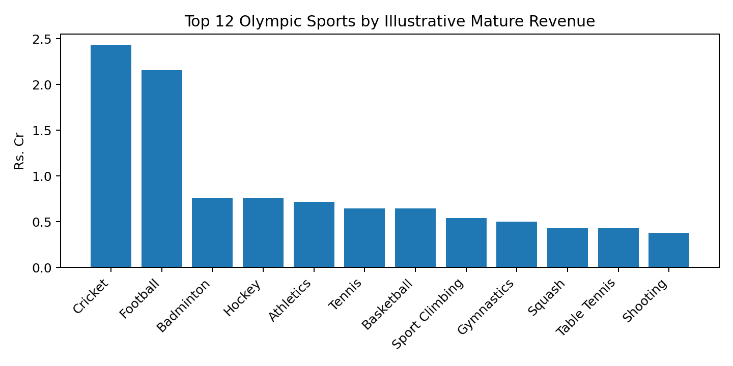
Olympic sports revenue dashboard
All 36 sports are in the model; chart shows the 12 highest illustrative mature revenues.
Cricket and football remain commercial anchors.
Orienting Academy | 19

Slide 20
Non-sport revenue engines
Programme | Revenue Rs. Cr
Academics - core tutoring | 2.70
STEM / Olympiad / enrichment | 0.90
After-school standard | 6.00
After-school extended | 3.60
Residential children | 2.43
Grandparents day programme | 1.44
Grandparents residential | 0.86
Community membership | 1.80
Family Elite membership | 2.40
Corporate leadership days | 1.80
Orienting Academy | 20

Slide 21
Operating and overhead costs
Cost block | Mature annual Rs. Cr
Loaded payroll | 11.66
Other direct + overhead | 15.20
Total operating cost | 26.86
Illustrative mature revenue | 53.41
Illustrative operating EBITDA | 26.55
Orienting Academy | 21

Slide 22
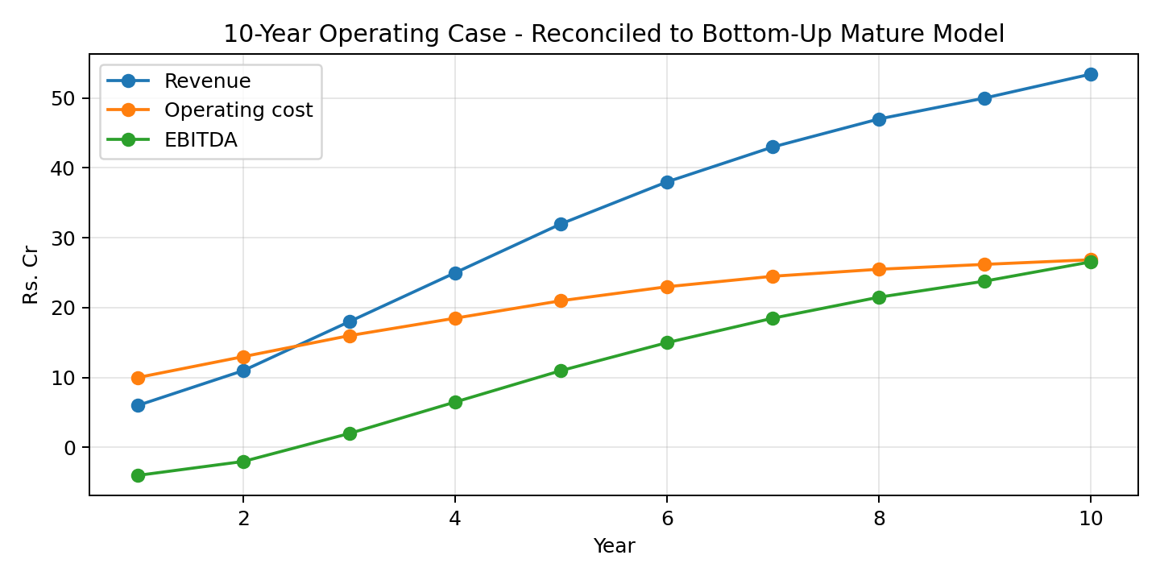
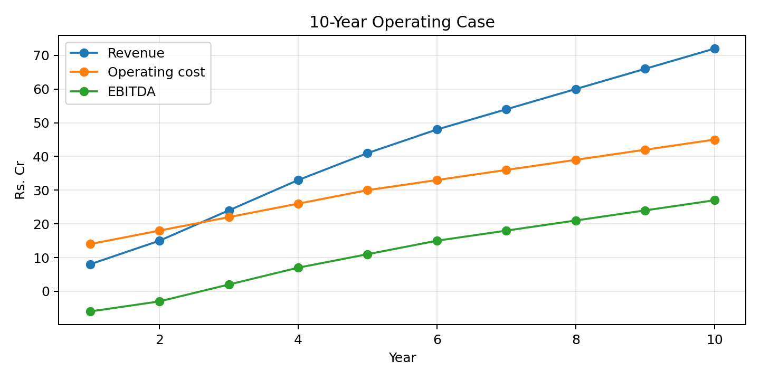
10-year operating case
Base case ramps over 10 years.
Figures are planning assumptions, not forecasts.
Orienting Academy | 22

Slide 23
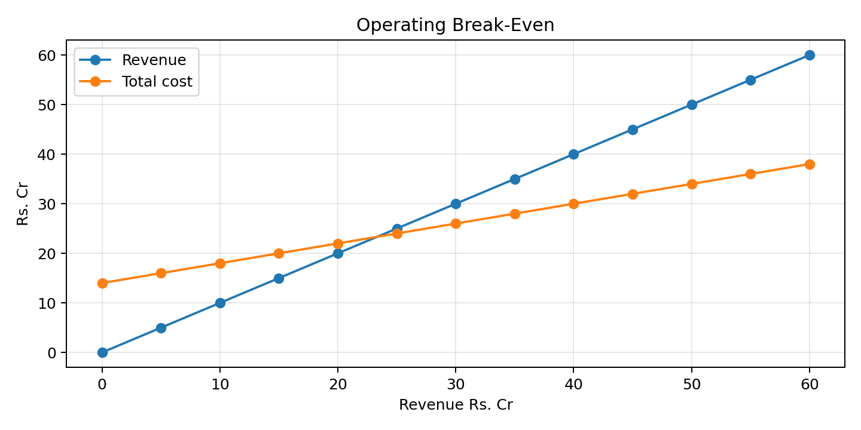
Operating break-even
Illustrative fixed cost: Rs.14 Cr.
Contribution margin: 60%.
Operating BEP revenue: ~Rs.23.3 Cr.
Orienting Academy | 23

Slide 24
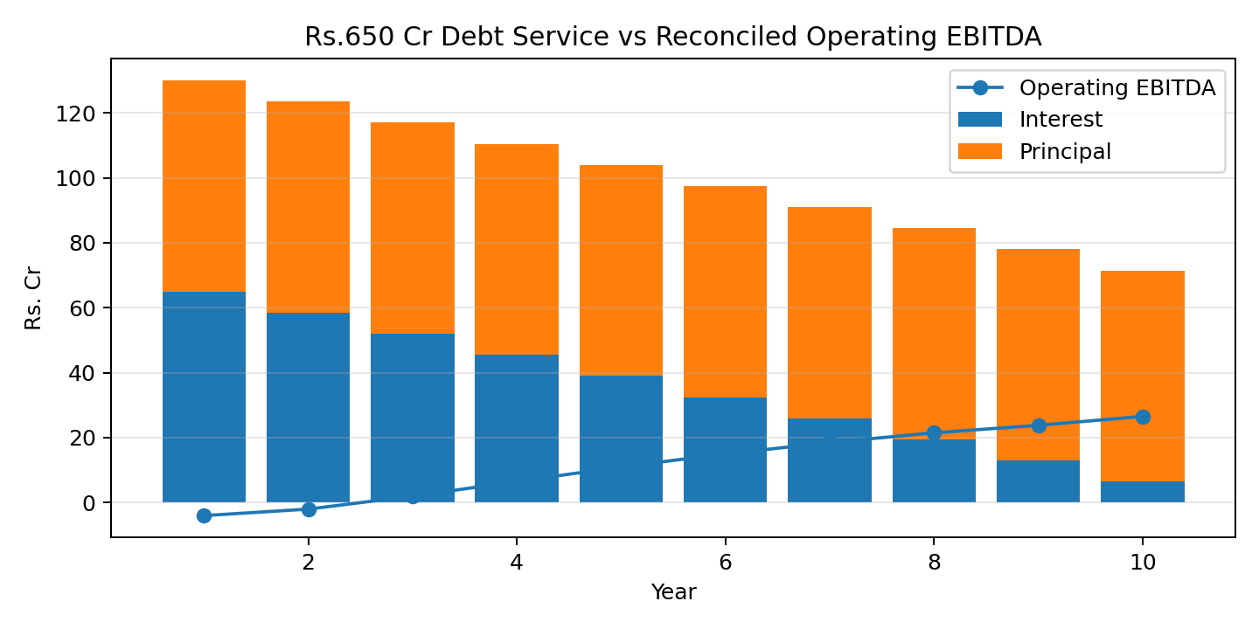

Rs.650 Cr debt stress test
Rs.500 Cr land + Rs.150 Cr development/operations.
10% stress interest.
10-year equal principal.
Orienting Academy | 24

Slide 25
Recommended capital structure
Separate land/asset SPV and operating company.
Use equity and longer-tenure infrastructure capital for land/buildings.
Size operating debt to DSCR, not to total aspiration.
Phase construction against memberships, school contracts and utilisation milestones.
Orienting Academy | 25

Slide 26
Corporate, school and NGO engine
Weekday school PE and leadership programmes.
Corporate experiential leadership and sports leagues.
NGO/CSR inclusion and scholarships.
Sports management services can scale beyond the 5-acre site.
Orienting Academy | 26

Slide 27
Competition and differentiation
Sports academies: strong in one sport, weak in family integration.
Tuition centres: academic only.
Clubs: recreation and membership, limited child-development integration.
Orienting Academy: MOVE + LEARN + LEAD + LIVE under one safeguarding system.
Orienting Academy | 27

Slide 28
Implementation roadmap
0-3 months: valuation, GIS catchment, parent survey, school database, legal notes and pilot LOIs.
3-9 months: sports + after-school + cafe + health room.
9-18 months: covered indoor sports, academics and B2B.
18-36 months: residential and senior living after validation.
Orienting Academy | 28

Slide 29
Investment gate / 90-day sprint
Do not commit the full capital before evidence is collected.
Validate land, demand, capex, compliance, staffing and school/corporate pipeline.
Rebuild lender model after signed pilot demand and engineering BOQ.
Orienting Academy | 29

Slide 30
Bibliography / source register
ID | Source | Quality
S01 | Olympics.com - LA28 sports update | Official IOC/Olympics
S02 | IOC - LA28 additional sports | Official IOC
S03 | LA28 competition schedule | Official Organising Committee
S04 | UDISE+ | Government of India
S05 | UDISE+ Know Your School | Government of India
S06 | MOSPI HCES 2023-24 | Government of India
S07 | Bengaluru Urban District Demography | Government of Karnataka
S08 | Karnataka DES DDP 2024-25 | Government of Karnataka
S09 | Karnataka DES Reports | Government of Karnataka
S10 | Edustoke Lingarajapuram | Market directory
S11 | UrbanPro Class I-V Lingarajapuram | Marketplace
S12 | UrbanPro Lingarajapuram Tuition | Marketplace
S13 | Sporthood football academy | Provider pricing
S14 | Sporthood Turfpark HSR football academy | Provider pricing
S15 | Gopalan Cricket Ground | Provider pricing
Orienting Academy | 30 | Sources: Full source URLs in DPR and Excel

Slide 31
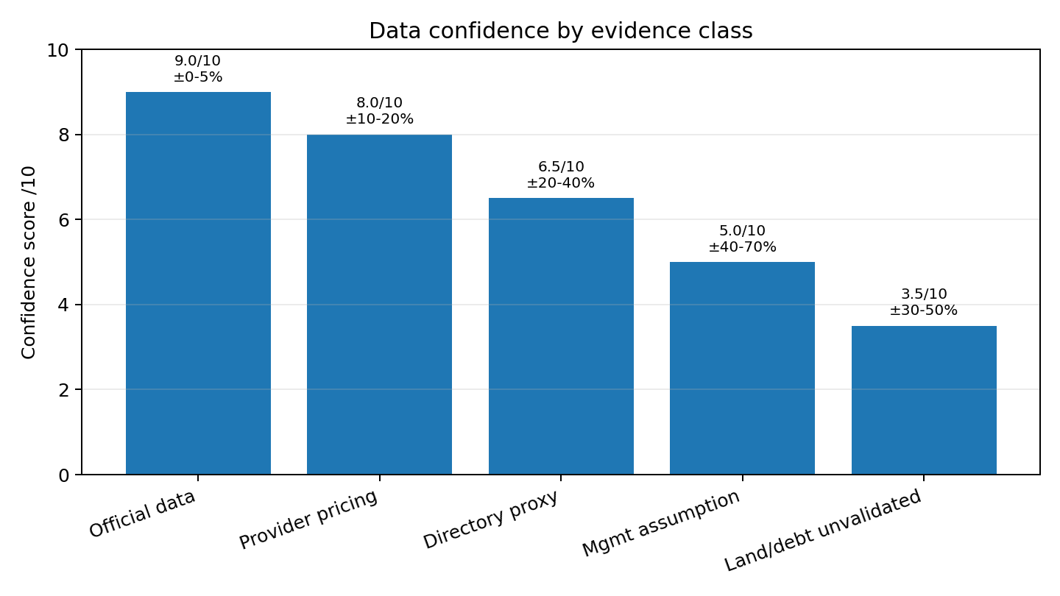
Data Accuracy & Assumption Error Control
Use this slide to explain what is verified, what is proxy data, and where the financial model can be wrong.
Decision rule for investor review
Class | Evidence | Typical error | Action before funding
A | Official / statutory | ±0–5% | Use as base fact
B | Provider price / quote | ±10–20% | Validate with 3–5 quotes
C | Directory / marketplace proxy | ±20–40% | Replace with field survey
D | Management assumption | ±40–70% | Stress test + pilot demand
E | Unvalidated land/debt | ±30–50%+ | Independent valuation + term sheet
Assumption-error exposure is highest in: 5-km household demand, residential children, grandparent occupancy, corporate/NGO contracts, coach/tutor wages, capex BOQ, and the Rs.650 Cr financing structure.
Each high-impact assumption must move from Class D/E to Class A/B before bank submission.
Add a model sensitivity tab: price, occupancy, wage inflation, capex, interest rate, rent/lease, and conversion.
Orienting Academy | 31 | Sources: Evidence hierarchy; bibliography in model

Slide 32
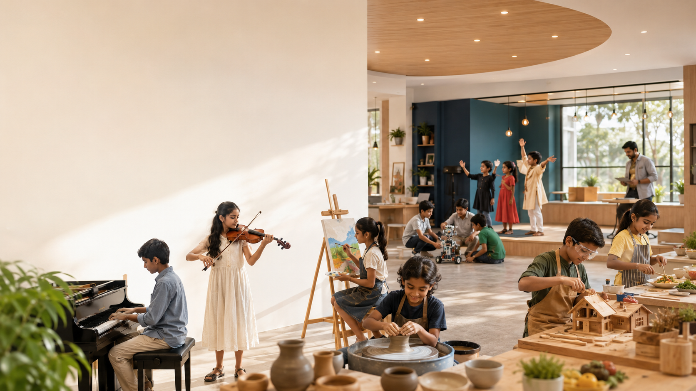
Arts + Professional After-School Programs
A fifth revenue pillar that supports creativity, confidence, life skills and career discovery.
Studio | Age | Offer
Western classical music | 5+ | Piano, violin, voice, ensemble
Painting & drawing | 4+ | Foundation art, exhibitions, portfolio
Pottery & ceramics | 6+ | Clay, wheel, kiln safety
Carpentry / woodworking | 8+ | Tool safety, model-making, maker craft
Cooking & nutrition | 7+ | Healthy food, kitchen safety, life skills
Theatre / public speaking | 6+ | Stage confidence, storytelling
Digital arts / media | 8+ | Design, photography, film, editing
Robotics / maker lab | 8+ | STEM, prototyping, entrepreneurship
Financial model add-on
Incremental mature revenue added in Excel: music, art, pottery, carpentry, cooking, drama, dance, media, digital design, robotics and entrepreneurship.
Treat as Class D assumptions until validated with teacher availability, studio capex, parent survey and competitor pricing.
Orienting Academy | 32 | Sources: Arts assumptions added to Excel

